Slide 1


CSE 2040
Programming IV
Lecture #28

Slide 2
What will we learn today
• Difference between function and method in Python
• Class definitions in Python
• Creating objects of classes in Python
Notes:
NoneType=type(None)
x=None
type(x)
type(x)==NoneType
isinstance(x,NoneType)

Slide 3
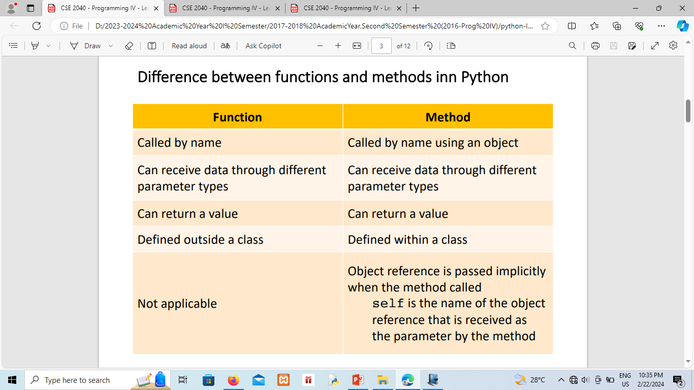
Difference between functions and methods in Python
Notes:
NoneType=type(None)
x=None
type(x)
type(x)==NoneType
isinstance(x,NoneType)

Slide 4
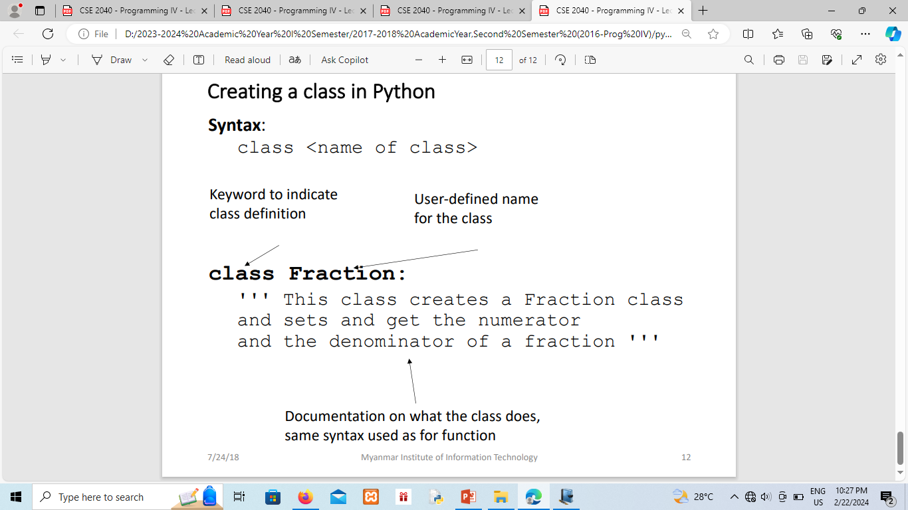
Function Decorators
Notes:
NoneType=type(None)
x=None
type(x)
type(x)==NoneType
isinstance(x,NoneType)

Slide 5
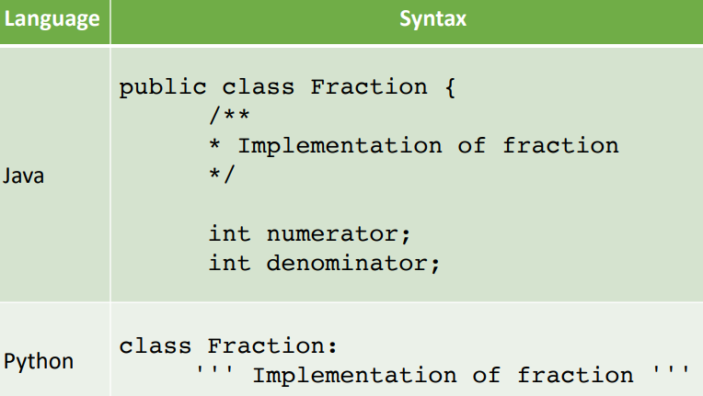
Defining a class
Notes:
NoneType=type(None)
x=None
type(x)
type(x)==NoneType
isinstance(x,NoneType)

Slide 6
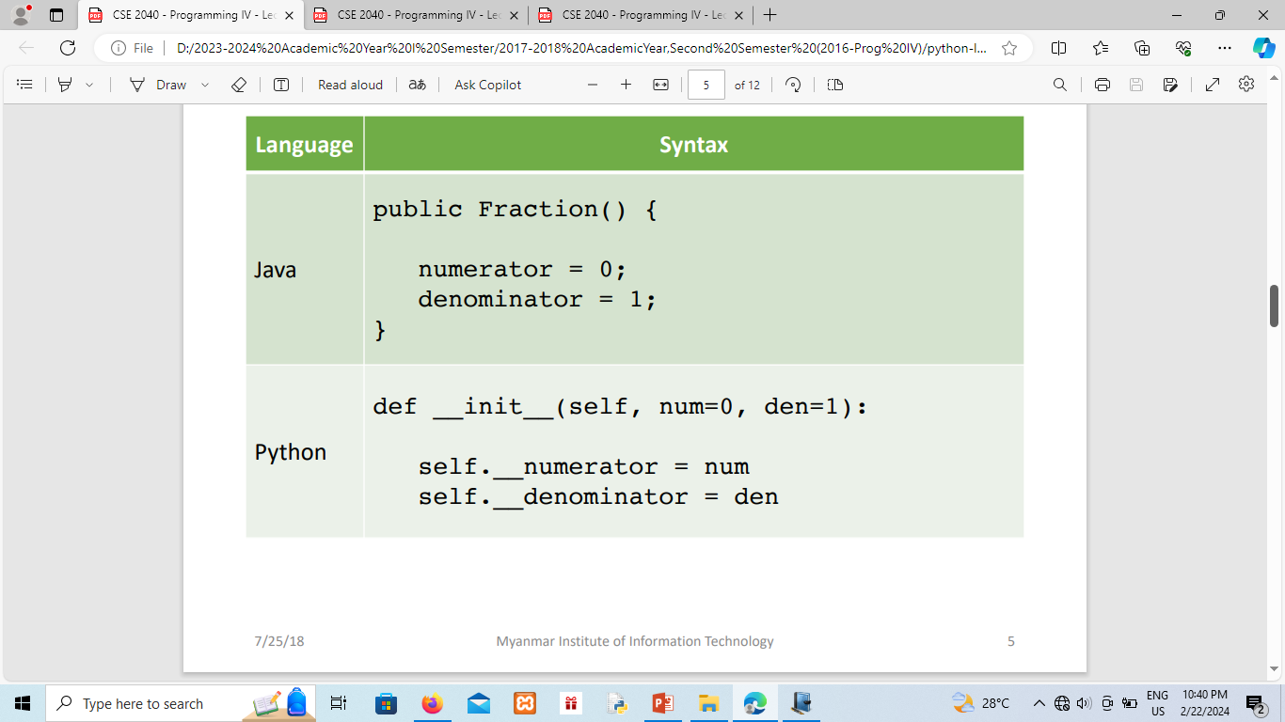
Defining constructor for a class
Notes:
NoneType=type(None)
x=None
type(x)
type(x)==NoneType
isinstance(x,NoneType)

Slide 7
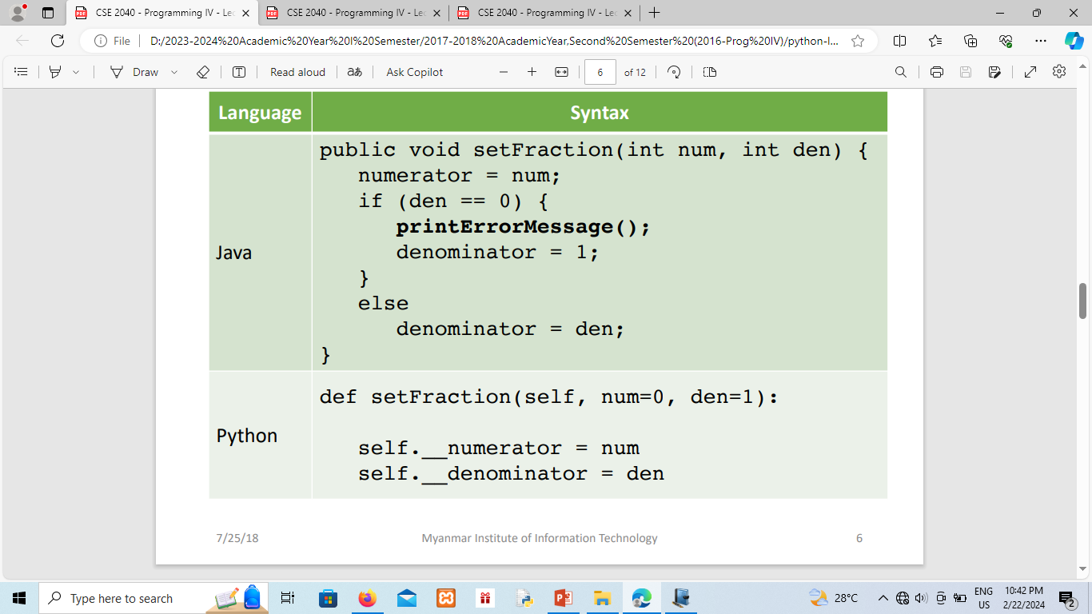
Defining method for a class
Notes:
NoneType=type(None)
x=None
type(x)
type(x)==NoneType
isinstance(x,NoneType)

Slide 8
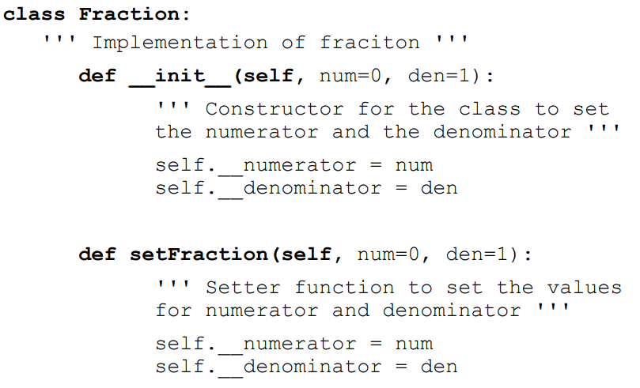
Putting class and methods together
Notes:
NoneType=type(None)
x=None
type(x)
type(x)==NoneType
isinstance(x,NoneType)

Slide 9
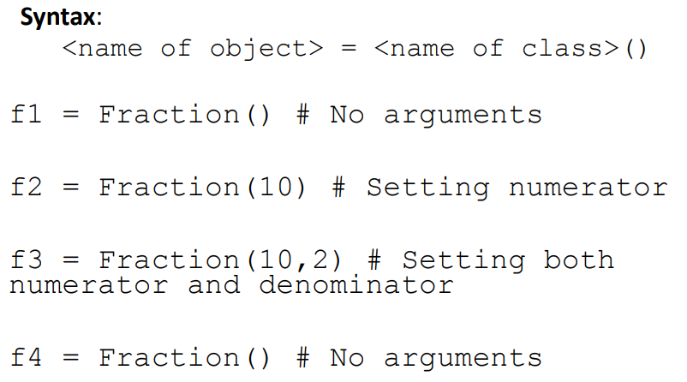
Creating an object of class Fraction
Notes:
NoneType=type(None)
x=None
type(x)
type(x)==NoneType
isinstance(x,NoneType)

Slide 10
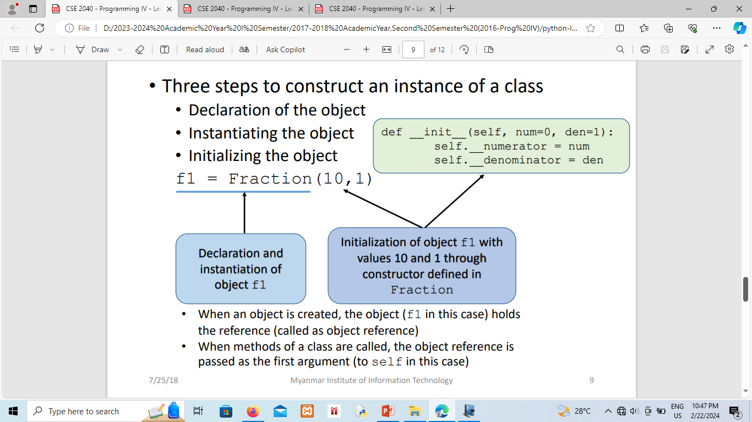
Object construction
Notes:
NoneType=type(None)
x=None
type(x)
type(x)==NoneType
isinstance(x,NoneType)

Slide 11
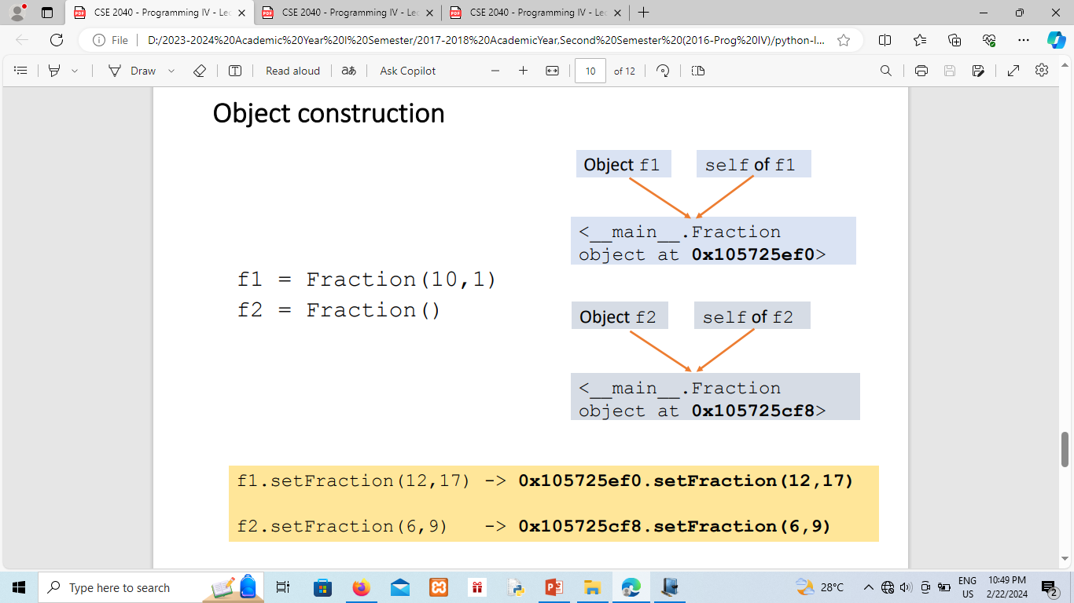
Object construction
Notes:
NoneType=type(None)
x=None
type(x)
type(x)==NoneType
isinstance(x,NoneType)

Slide 12
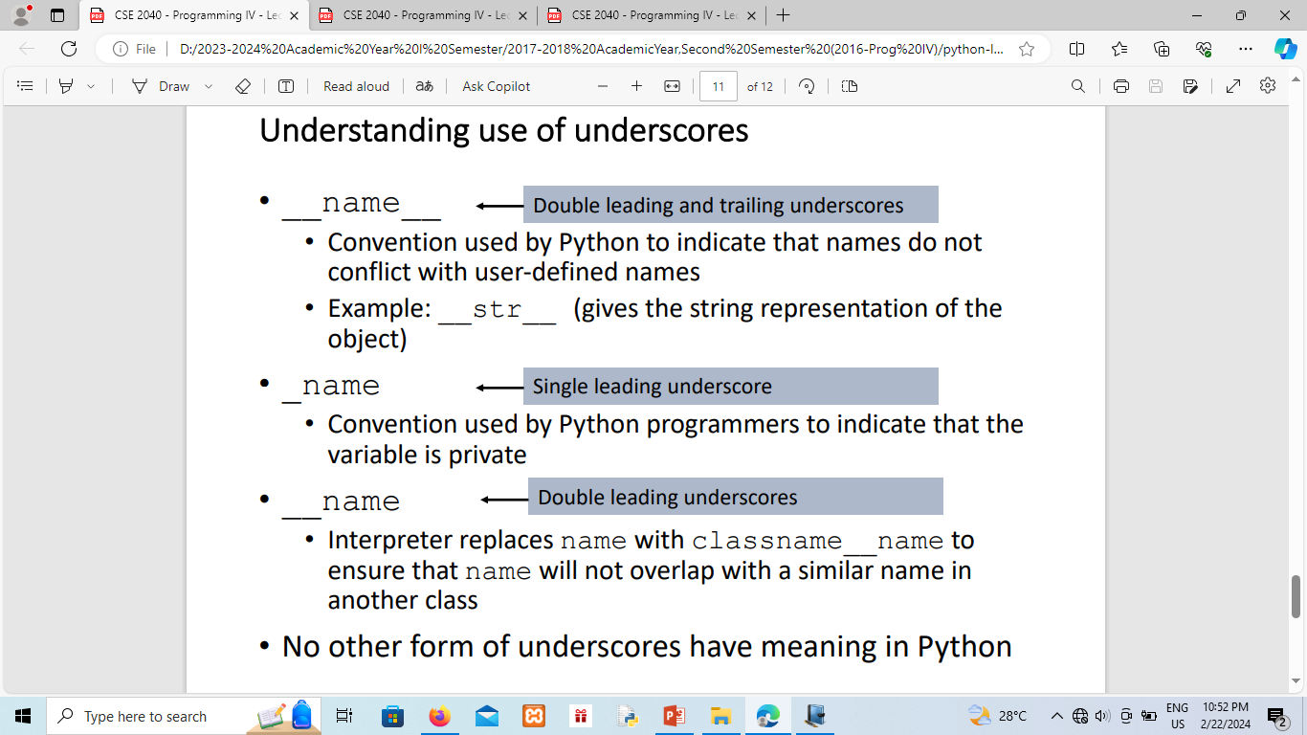
Understanding use of underscores
Notes:
NoneType=type(None)
x=None
type(x)
type(x)==NoneType
isinstance(x,NoneType)

Slide 13
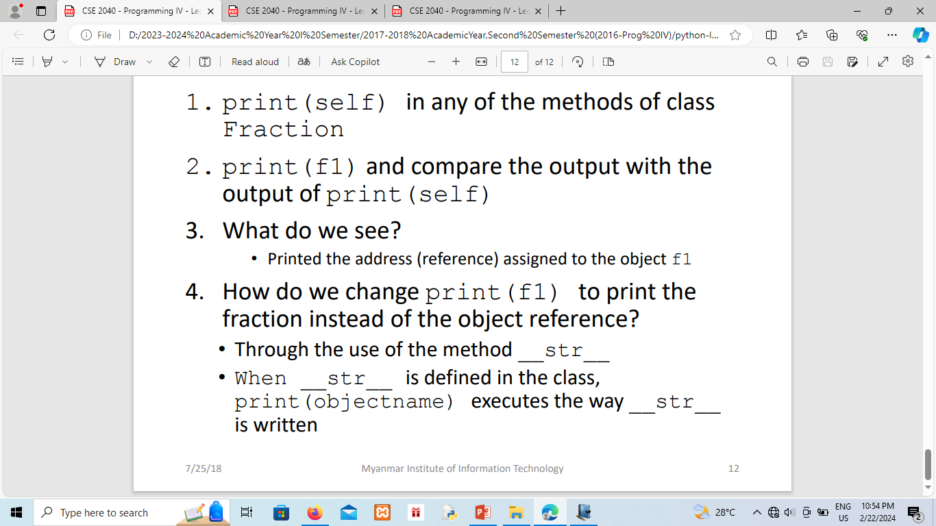
Testing out somethings
Notes:
NoneType=type(None)
x=None
type(x)
type(x)==NoneType
isinstance(x,NoneType)

Slide 14
References
Professor Usha lecture slides
Dr. R. Nageswara Rao, Core Python Programming, Second Edition, 2018

